Slide 1
Website corrections

Slide 2
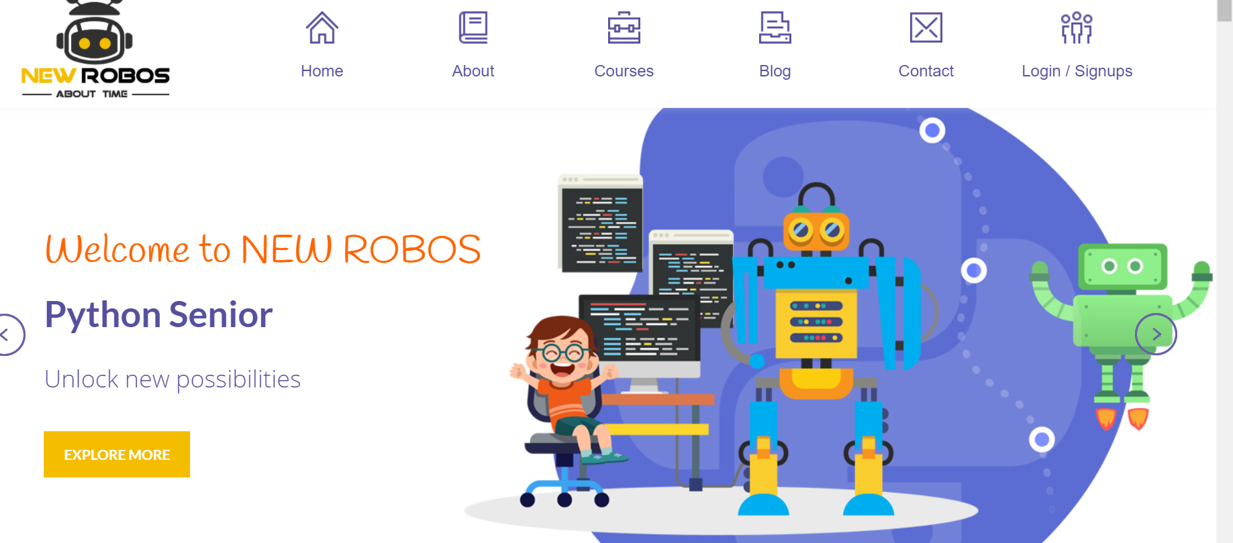
1. Signups – remove s 2. Click explore more 404 error appears
DONE

Slide 3
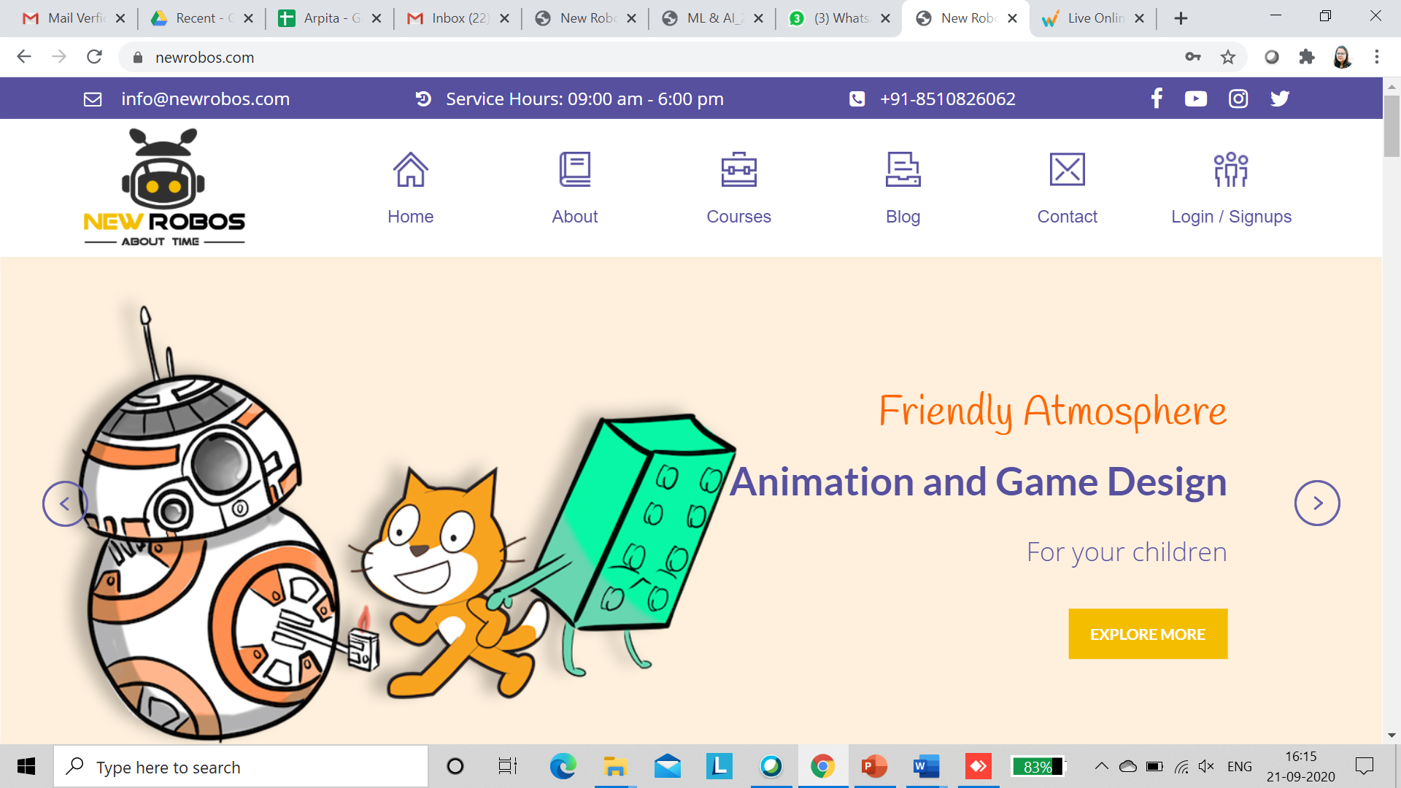
Service Hours: 10:00 am- 7:00 Pm
DONE

Slide 4
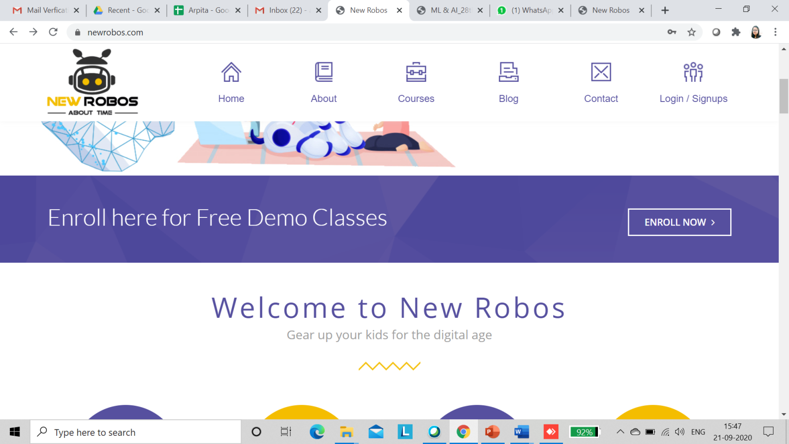
Free Demo Form not working

Slide 5
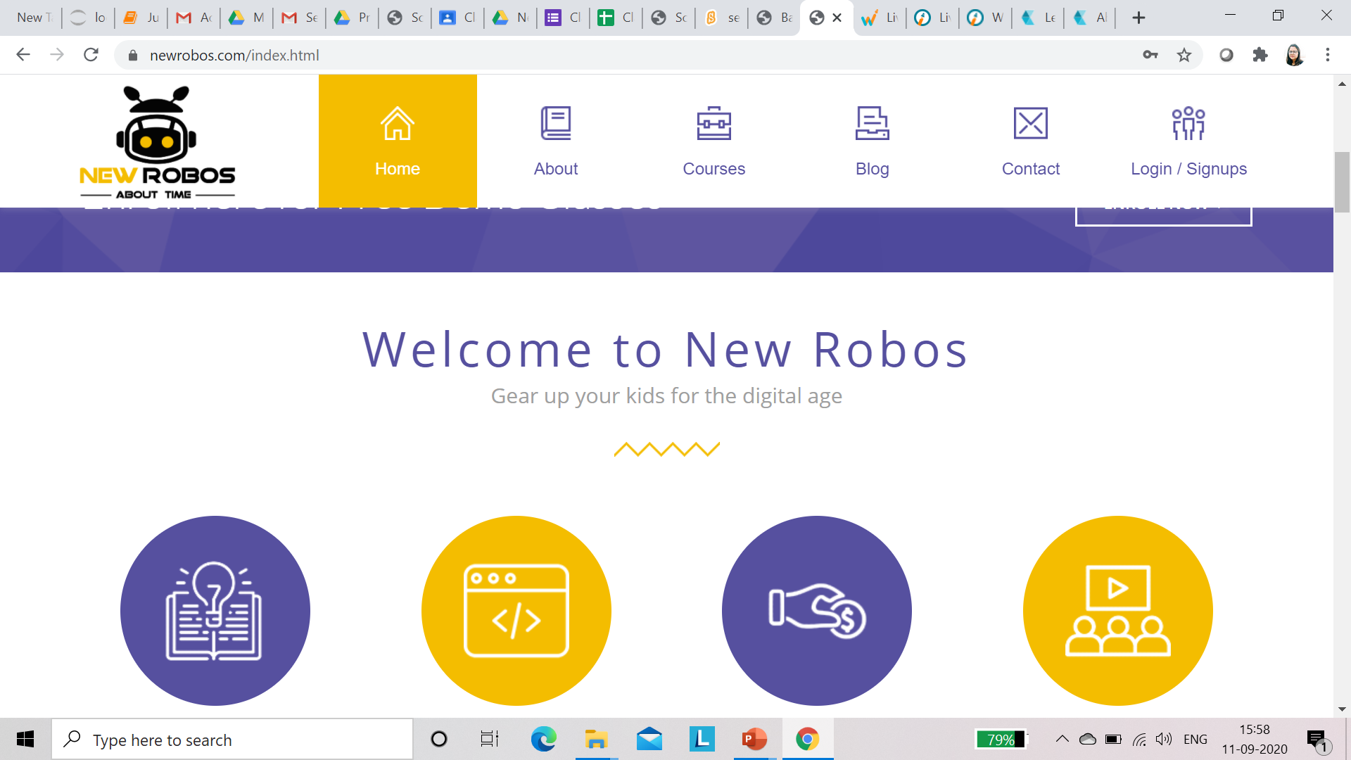
Home page feedback
DONE
Spacing between statement and zigzag line

Slide 6
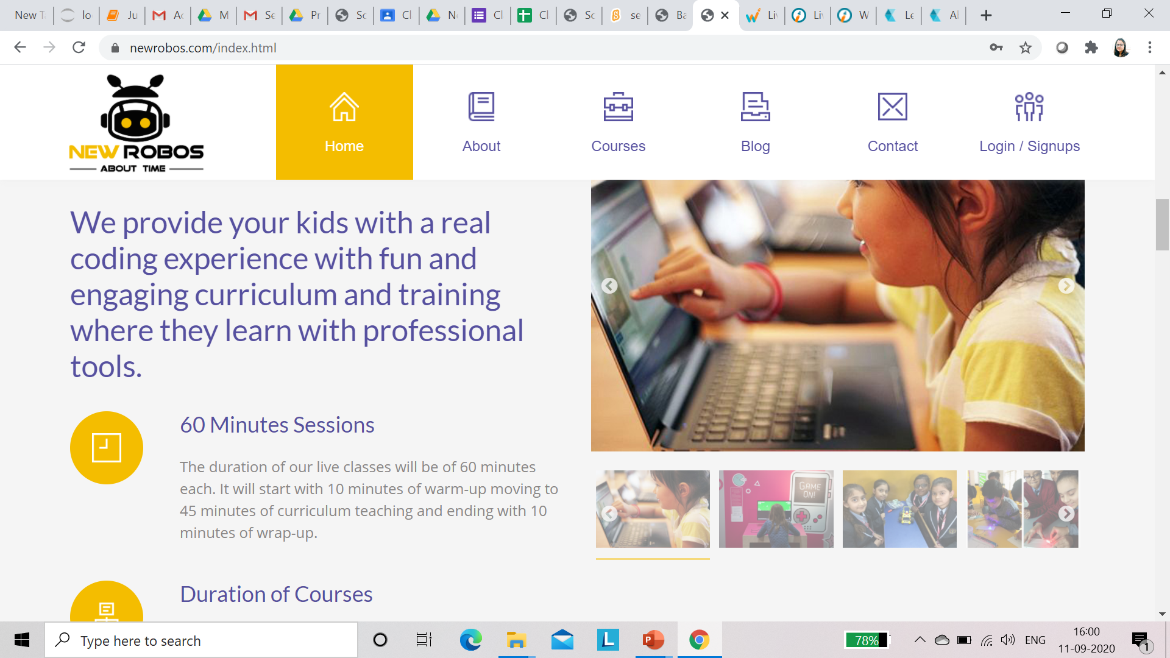
1. Reduce the font size and justify –we provide …….
DONE

Slide 7
Remove 60 Min content and write Coding for Kids - We have developed programming courses that allow kids, teenagers, and young adults to learn how to code with live online coding classes and in an environment that works for them.
DONE

Slide 8
Remove duration of courses and write- Excellent program - programs designed to stimulate creativity, problem-solving skills, and academic performance overall.
DONE

Slide 9
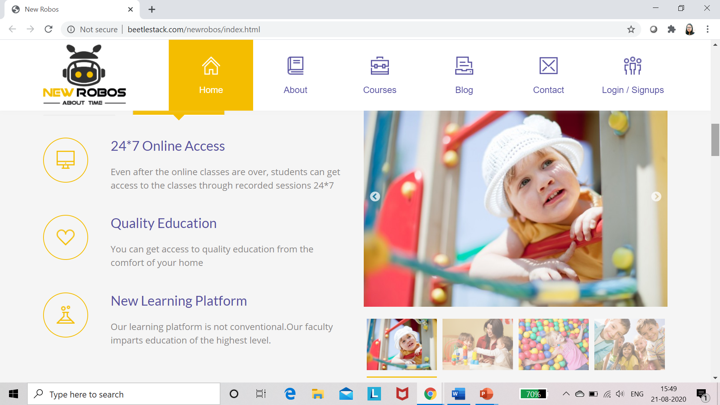

Slide 10
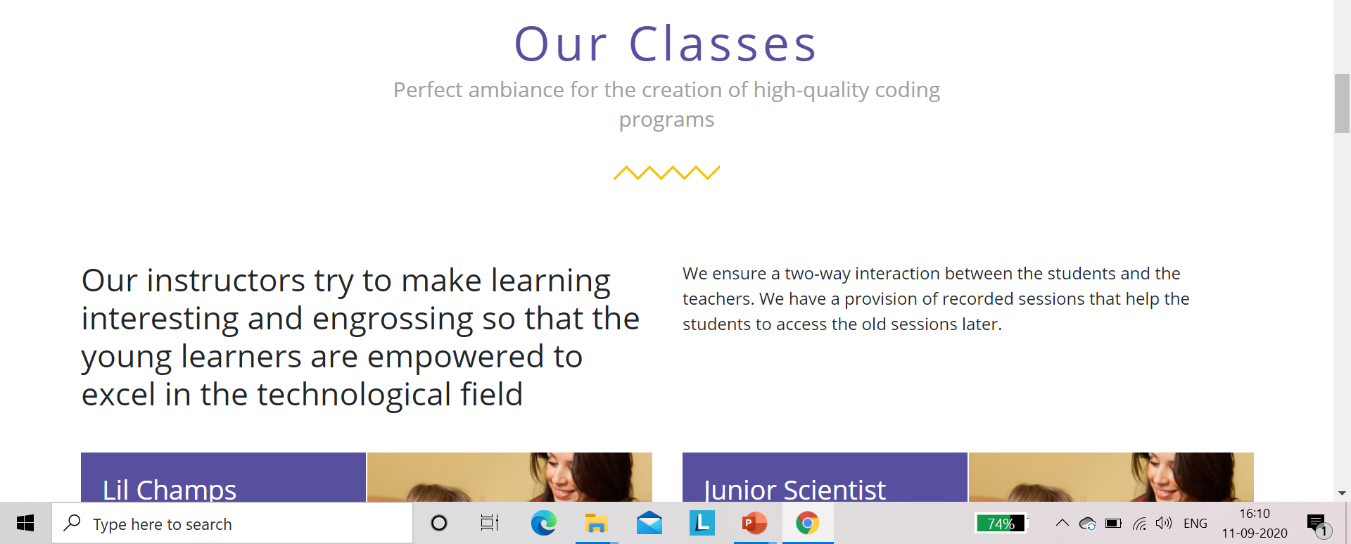
Every content should be centerd
Space between content and line
Compare the font size

Slide 11
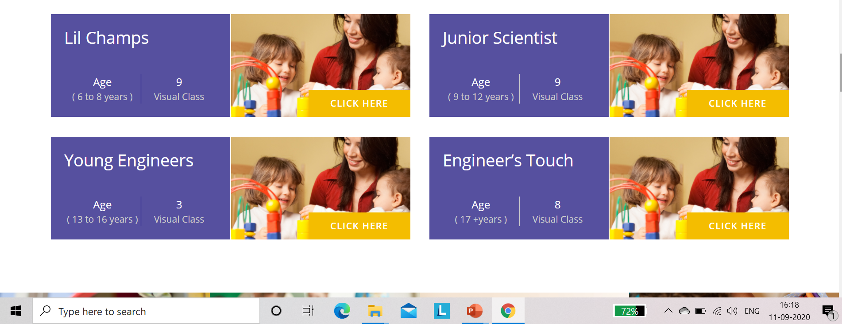
Remove all pics,
Requried Pic
DONE
Remove visual classes and write live session 24 in all 4 courses

Slide 12
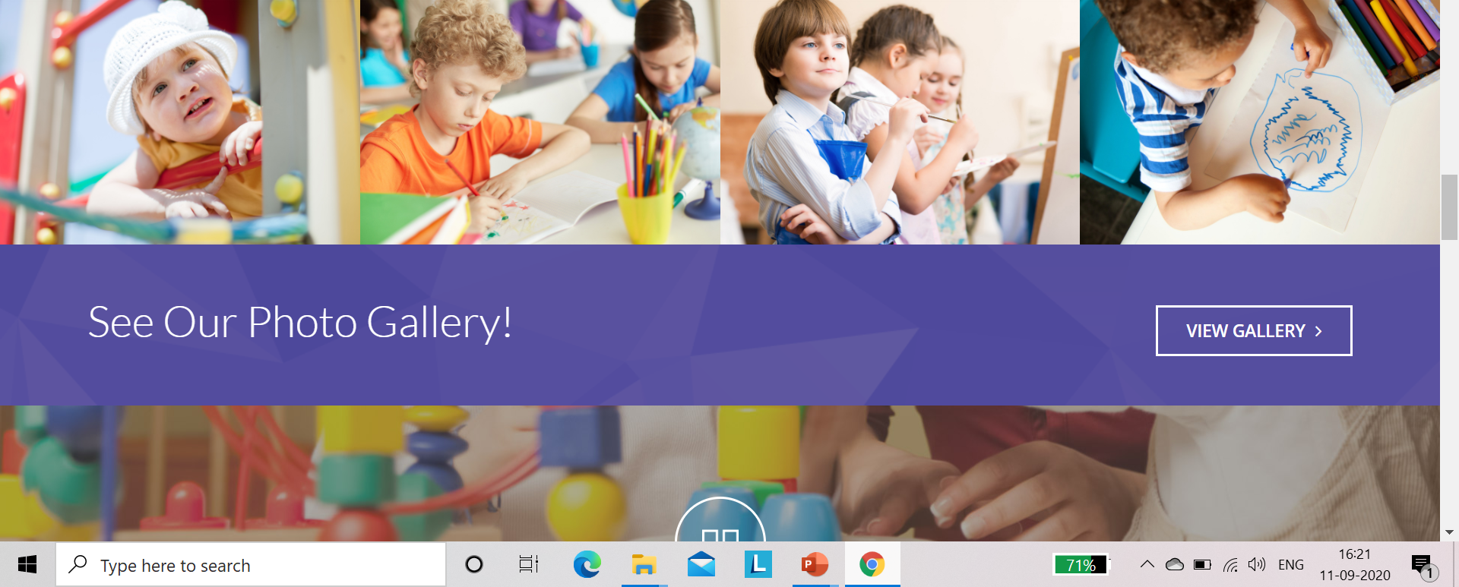
Change all pics
requried

Slide 13
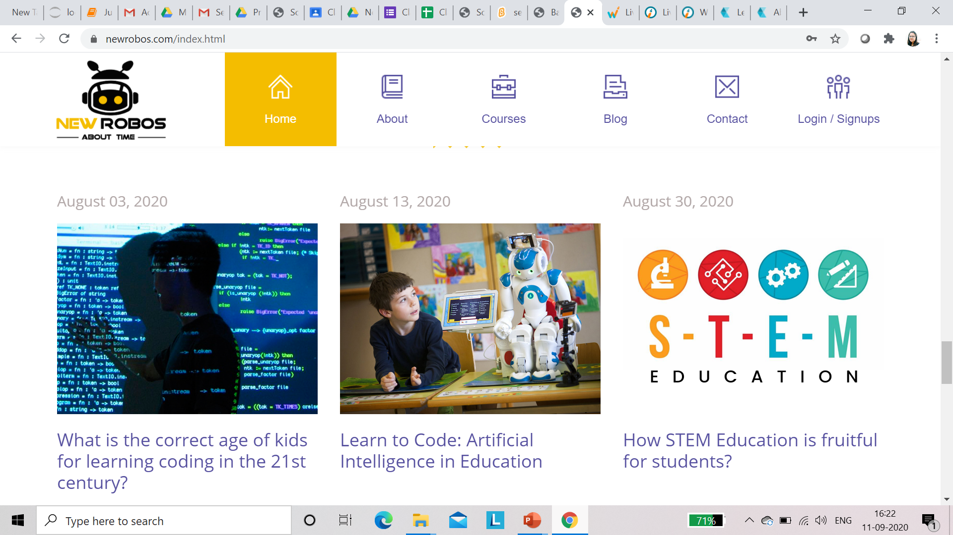
1. Arrange blogs : latest at the top 2. Change pic of blog Aug 3 – 2020
requried

Slide 14
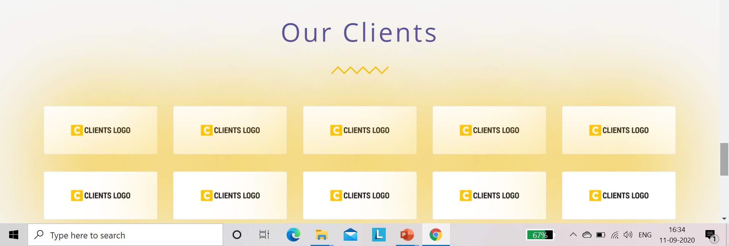
Remove Our Clients and write – Trusted by schools we provide logos of school
Client logo requried

Slide 15
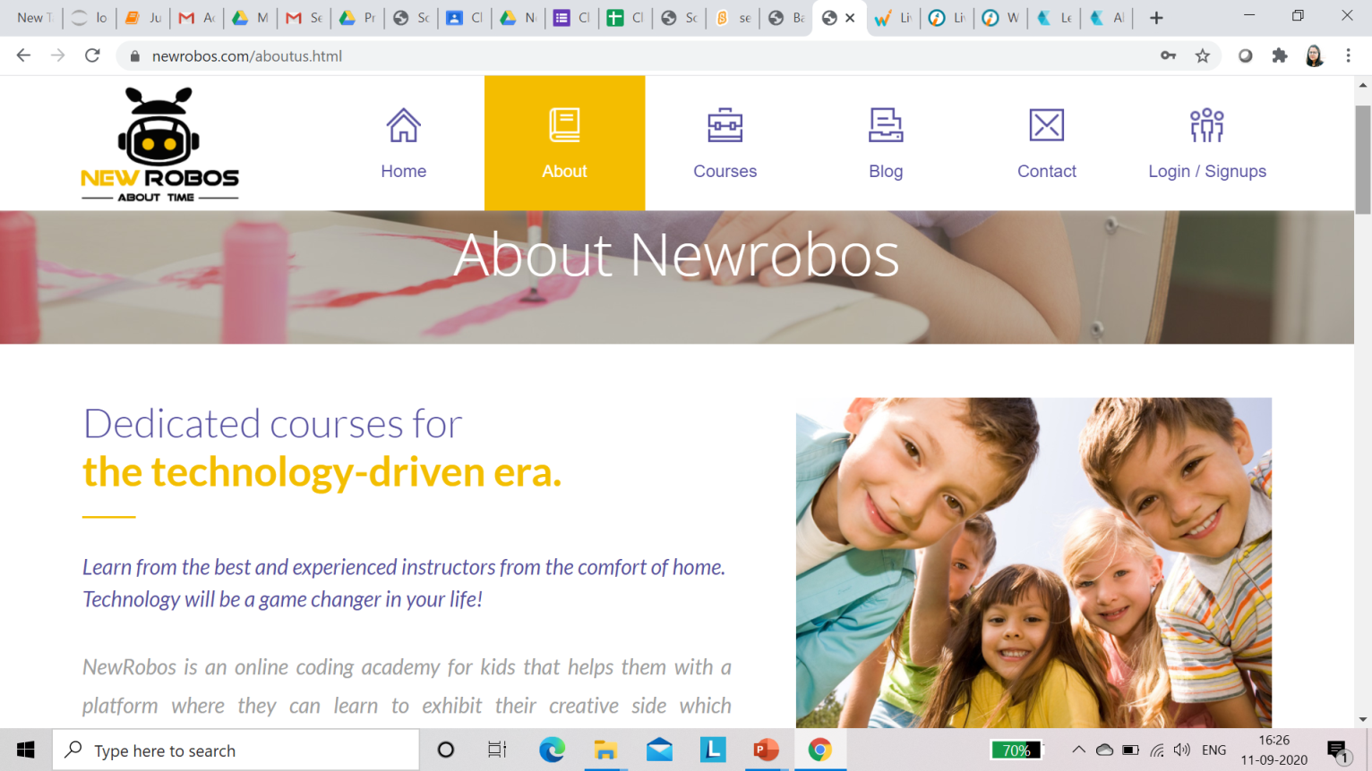
IN ABOUT US 1. Remove the children photos 2. Content should given some sub headings
Done

Slide 16
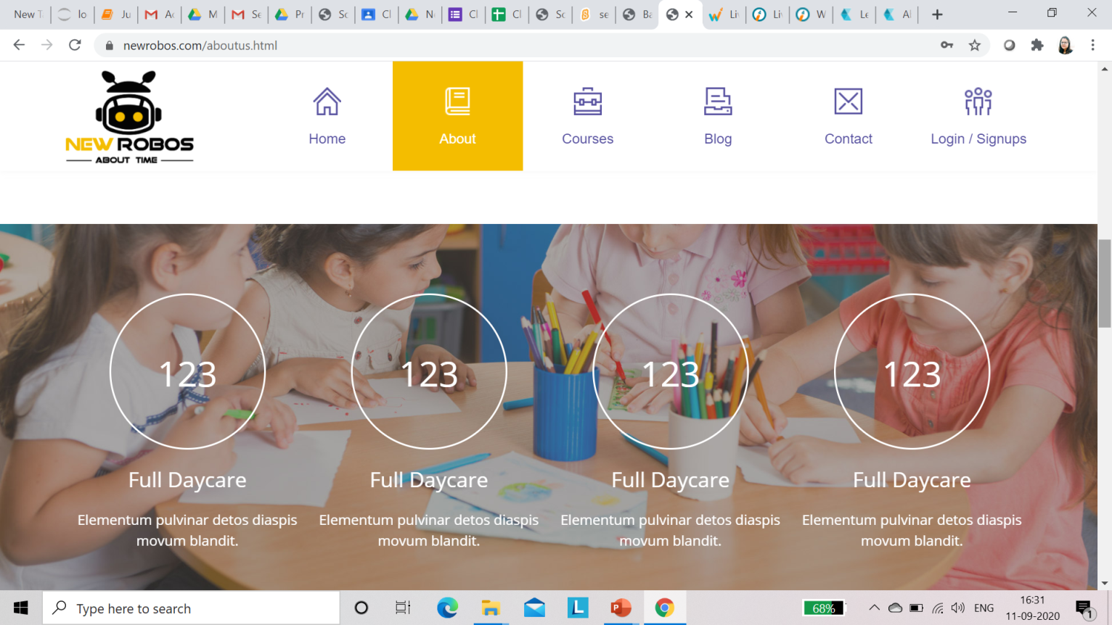
Replace 123 full day care by curriculum designed by mentors IIT - D logo NIT logo IIM logo
Done and logo Requried

Slide 17
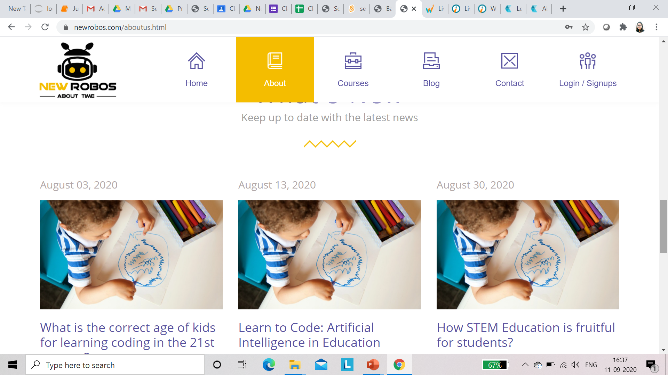
1. Space between zigzag line and content ------Done 2. Latest blog at 1st 3. provide link of blogs ----Developer task

Slide 18
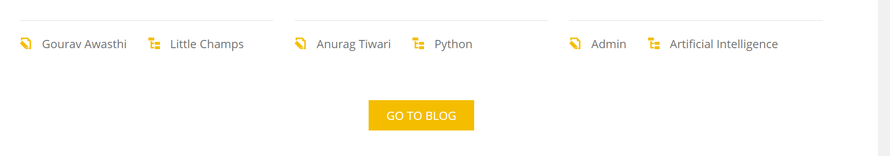
What does it shows???
Not clear

Slide 19
Change Image
Packages should mention the full price of the each course
Novice- session*per session rate
Developer- session*per session rate
Champion- session*per session rate
Not Done

Slide 20
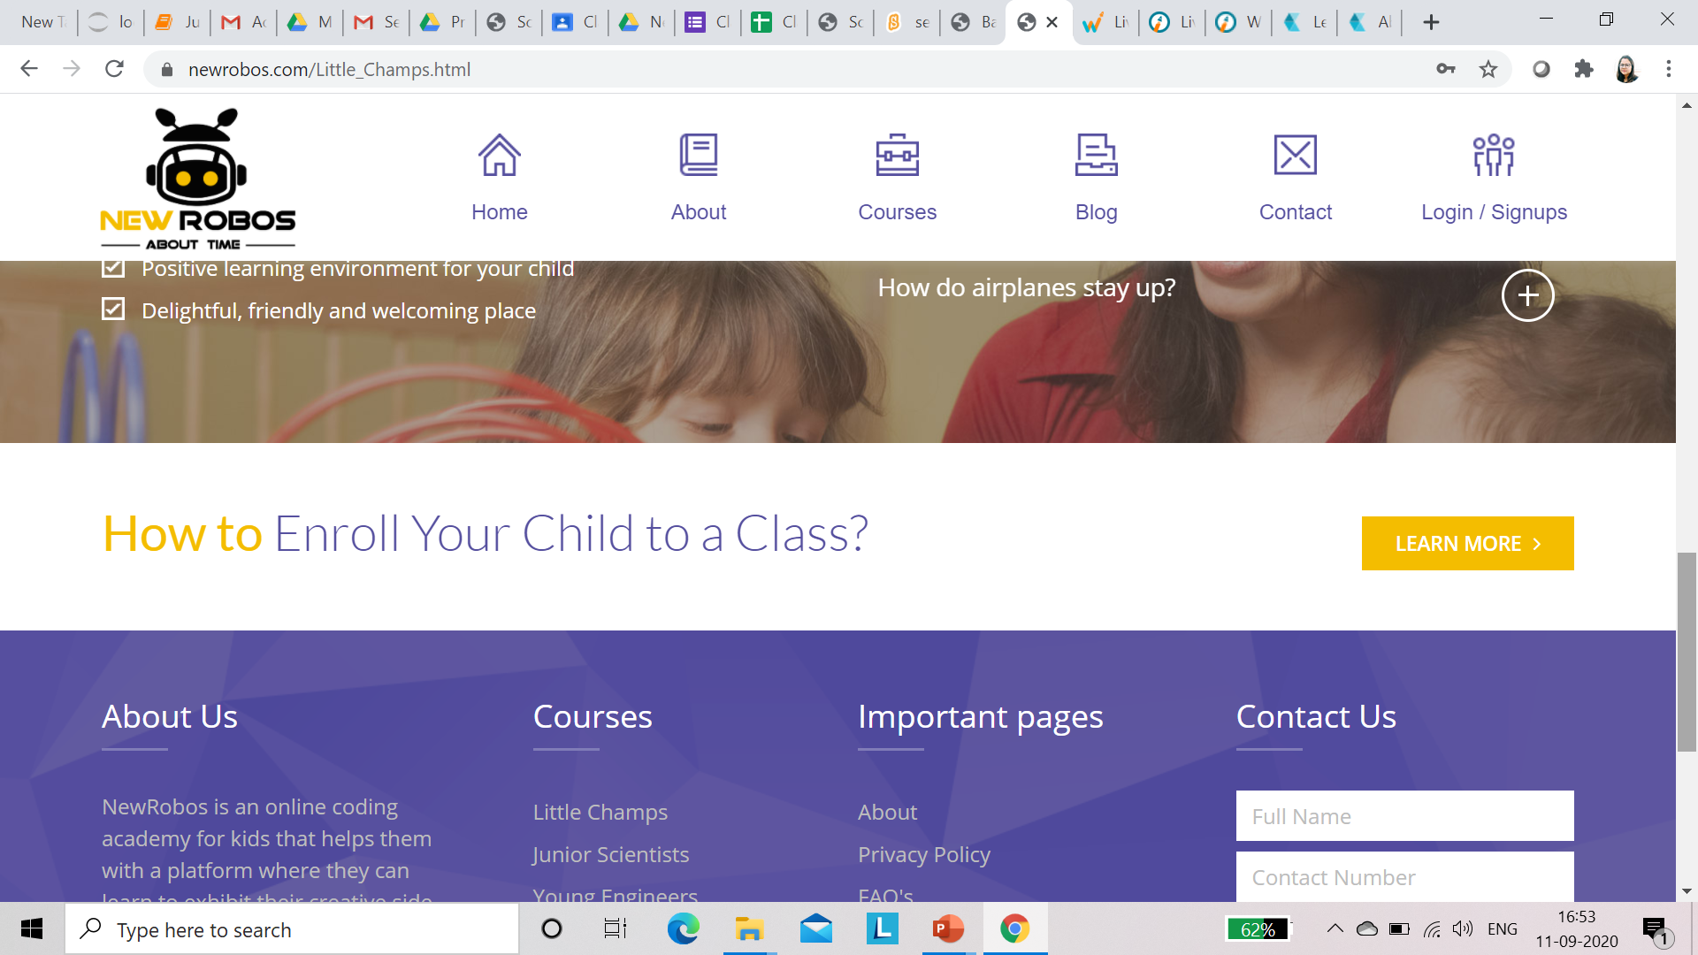
Write – book a free demo button
Remove this line -How to enroll

Slide 21
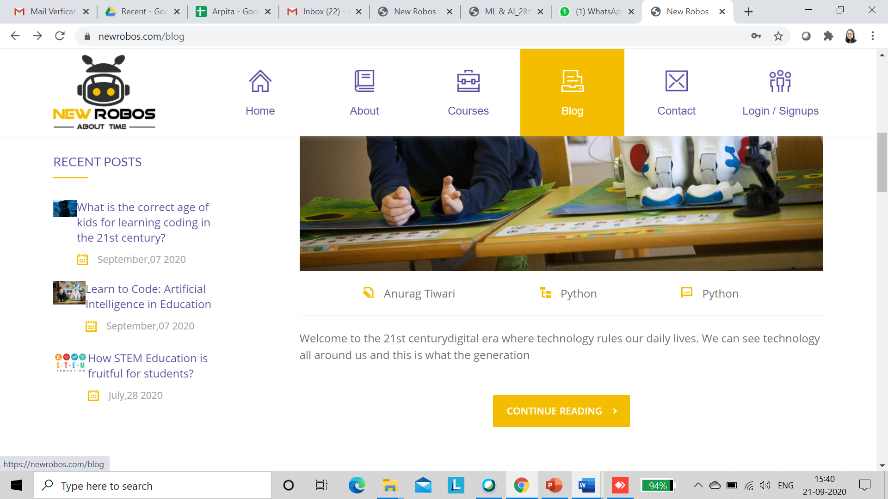
BLOGS – When we press continue reading content of blog is not appearing in all blogs section

Slide 22
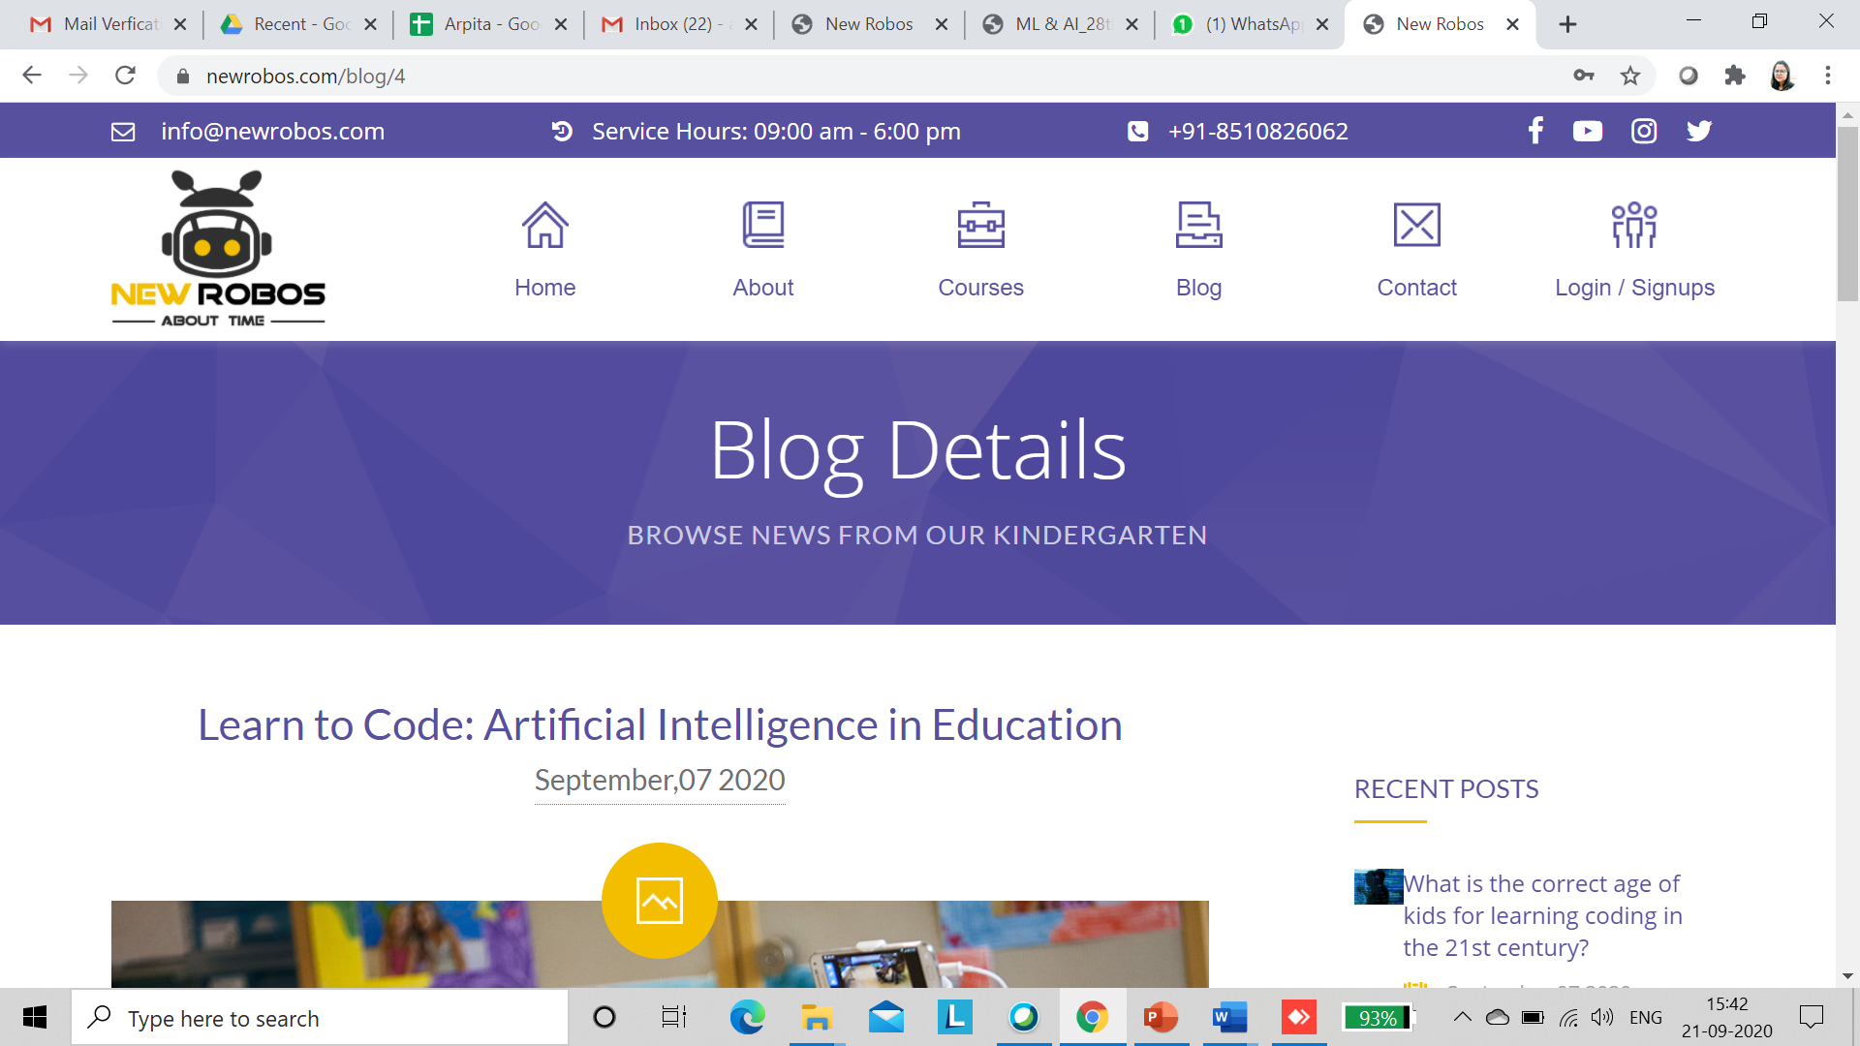
Remove Browse news from Kindergarten

Slide 23
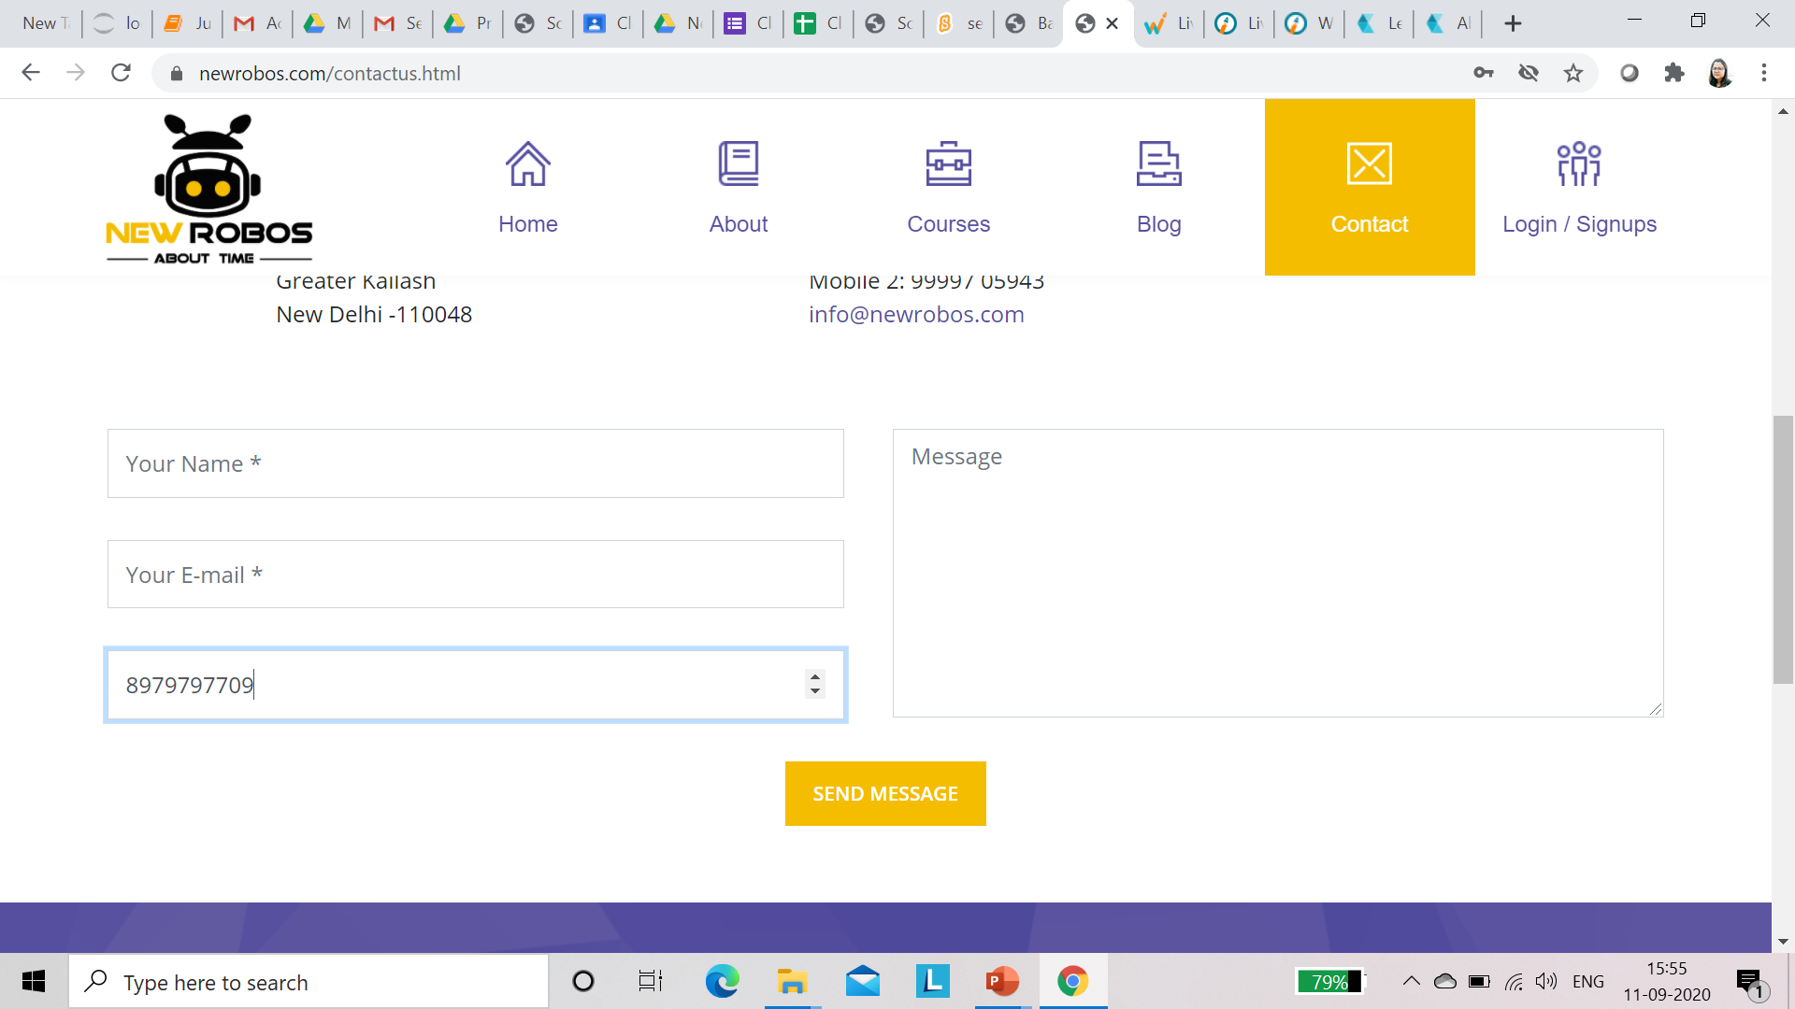
Please correct details in form name, mail and number

Slide 24
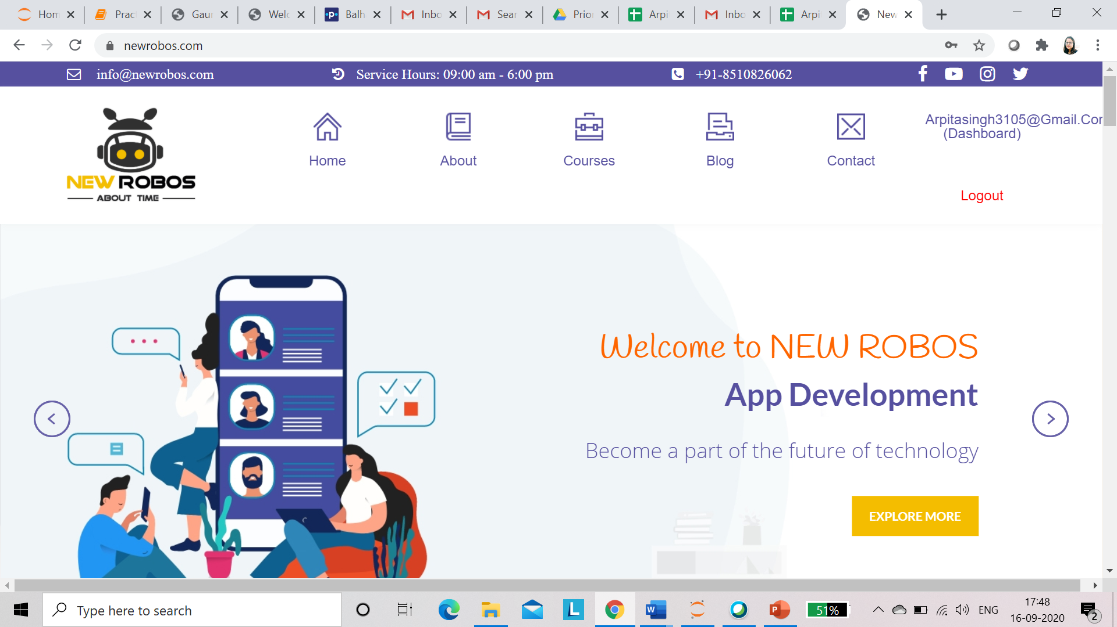

Slide 25
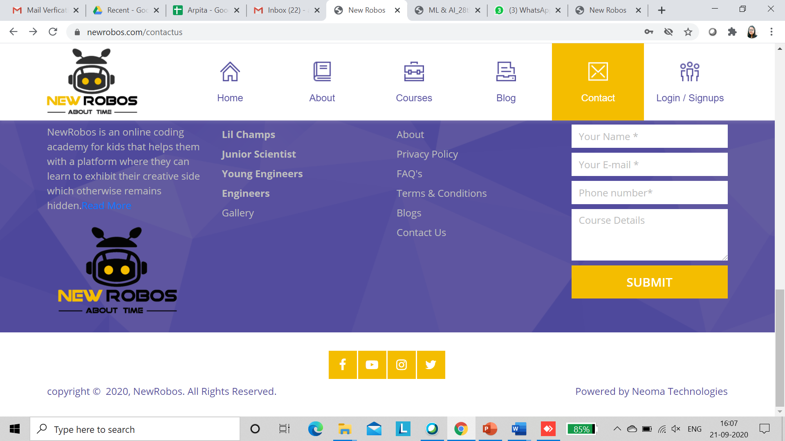
https://whitehatjr.com/curriculum : check the footer “made with love in india” instead of powered by neoma technologies

Slide 26
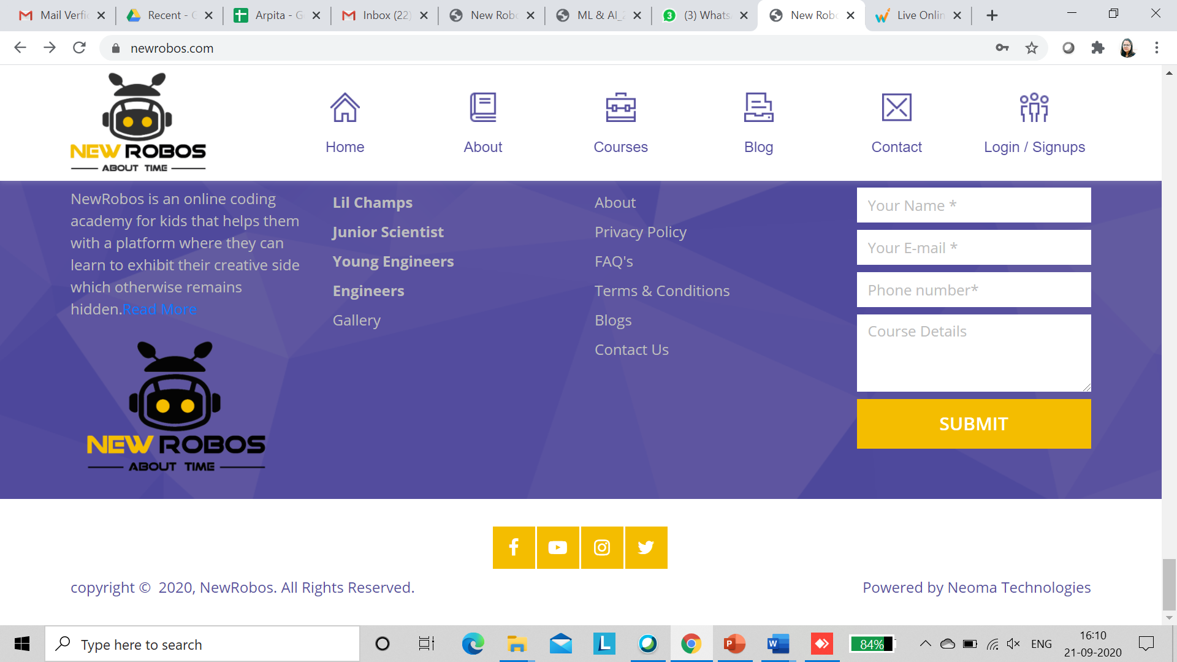
Links not working

Slide 27
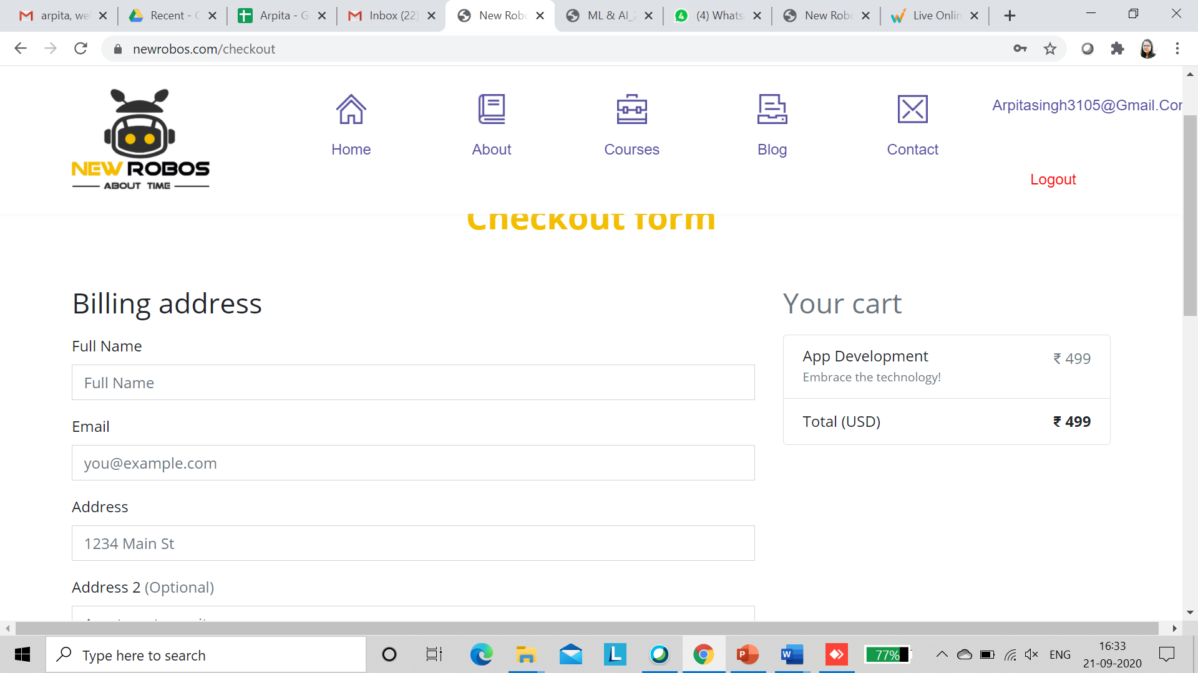
Discount Coupon code should be display

Slide 28
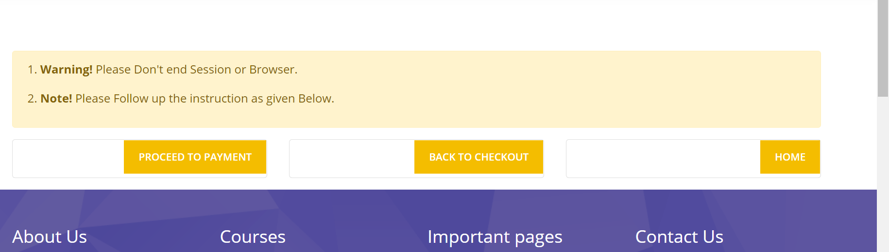
Why white box is displayed? Use image

Slide 29
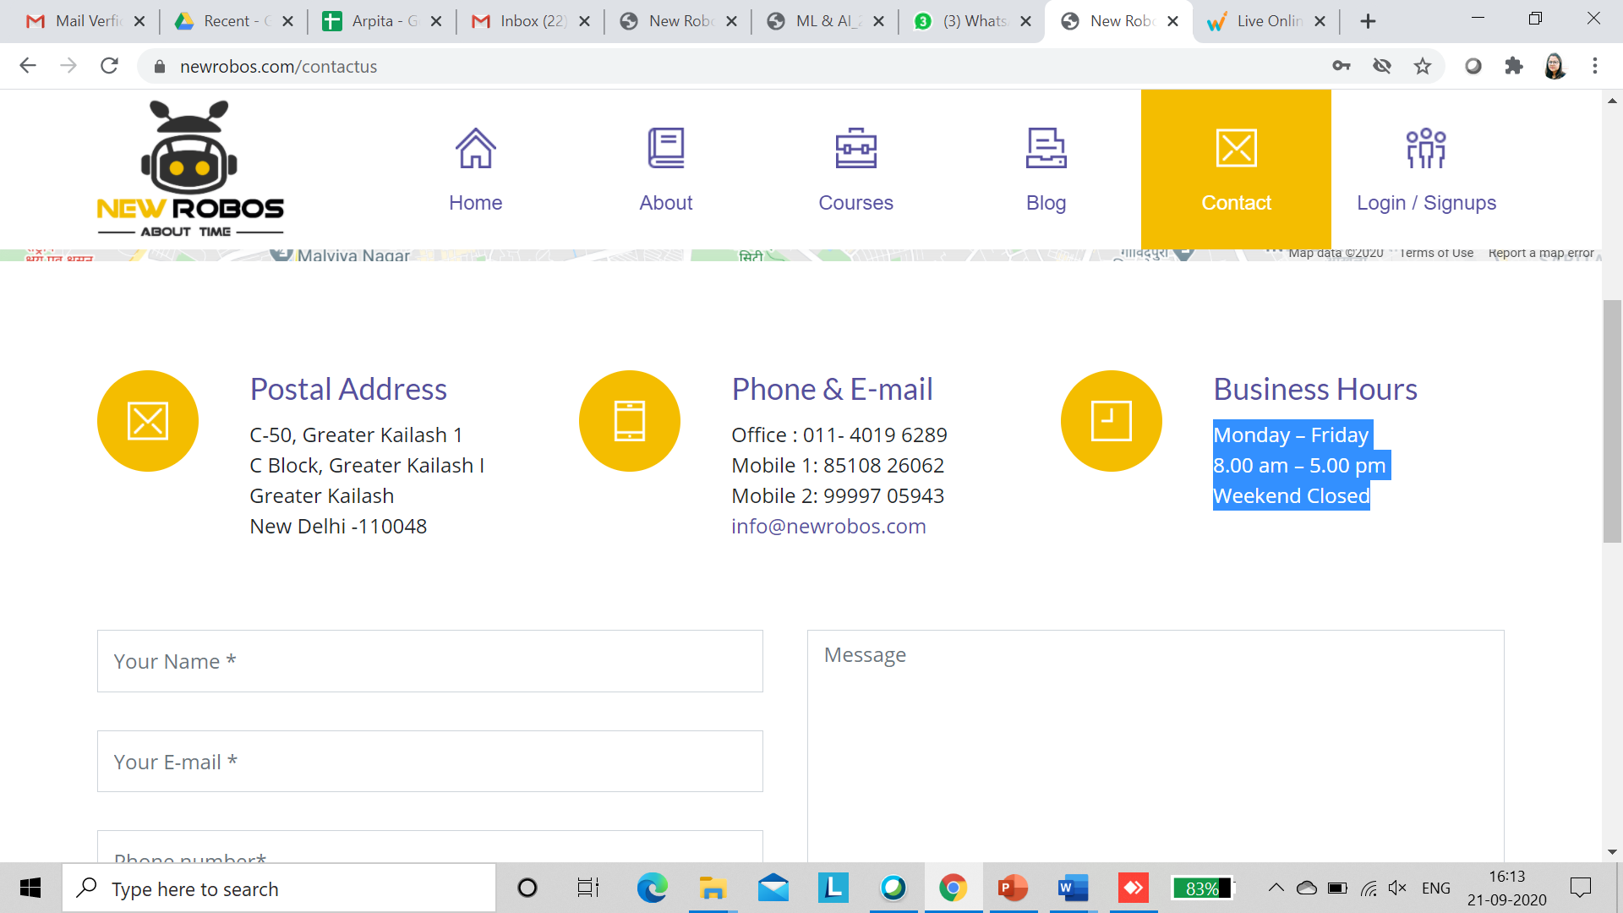
Monday – Saturday 10:00 A.M- 7:00 P.M Remove weekend closed

Slide 30
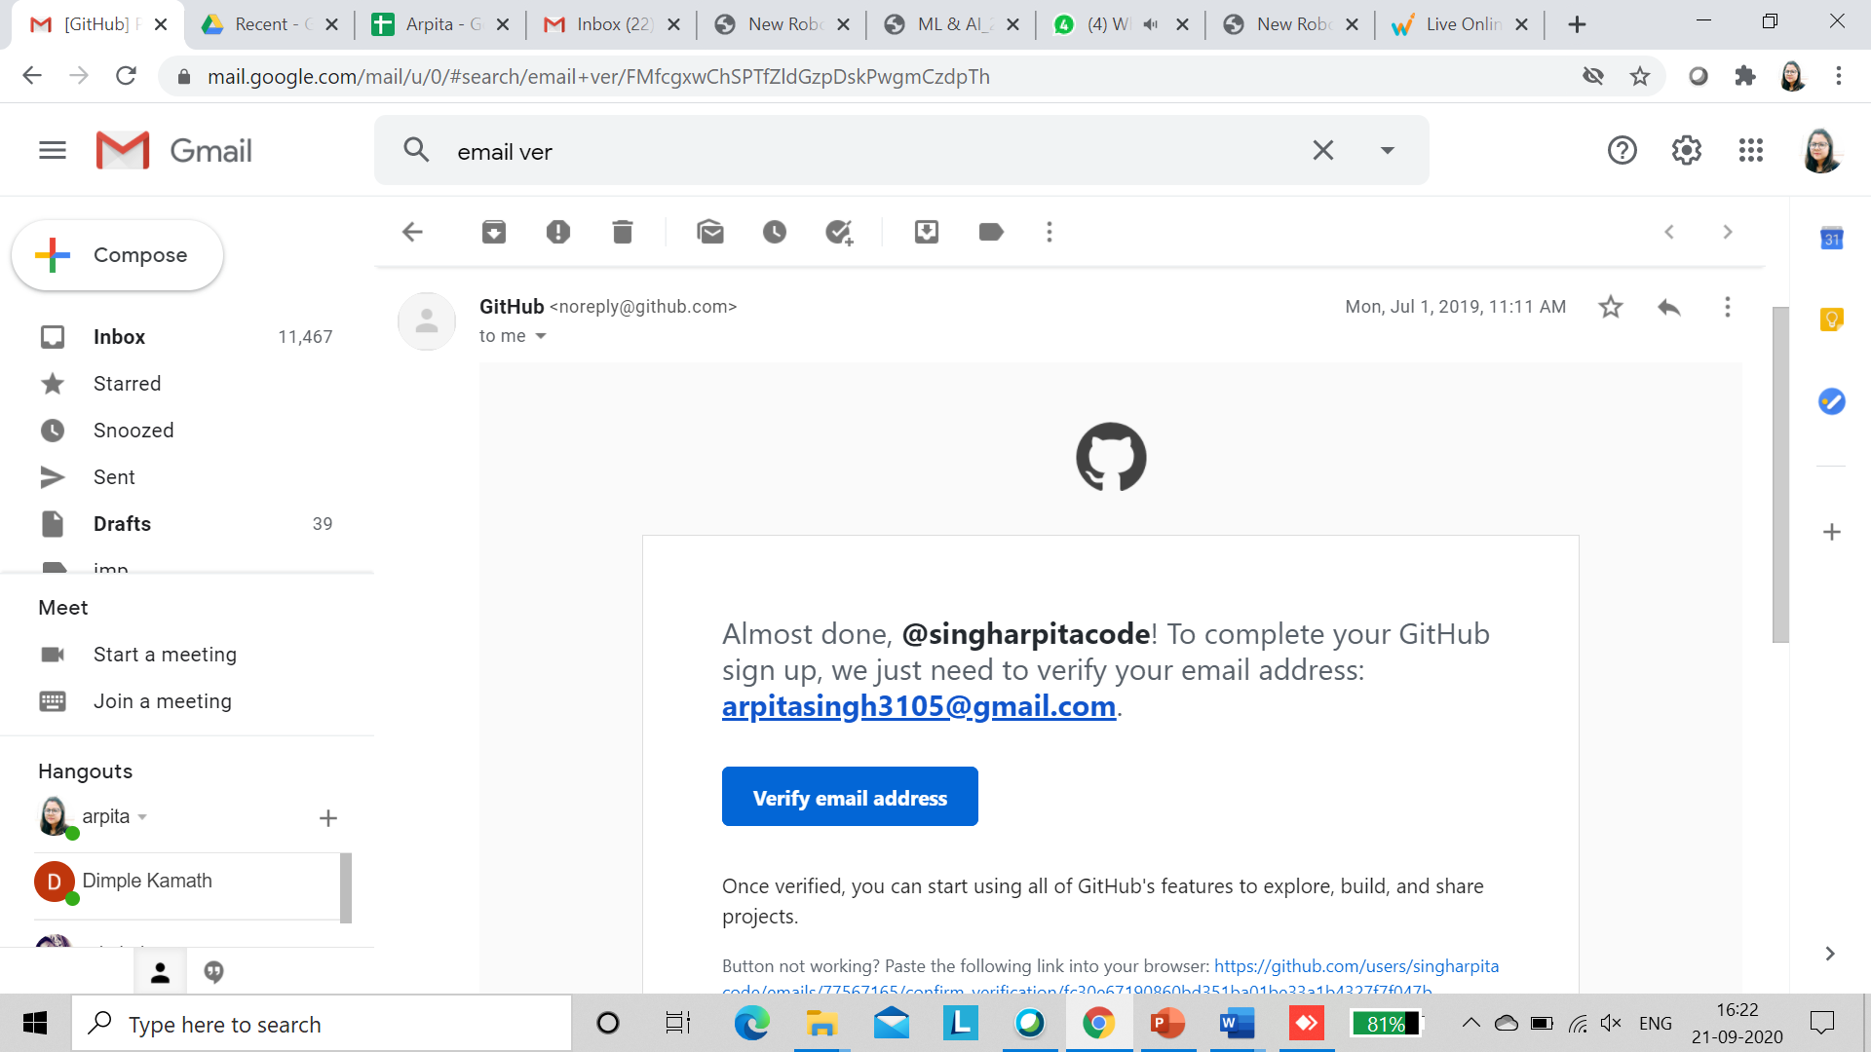
LOGO At Top of the email Content as below for email verification

Slide 31
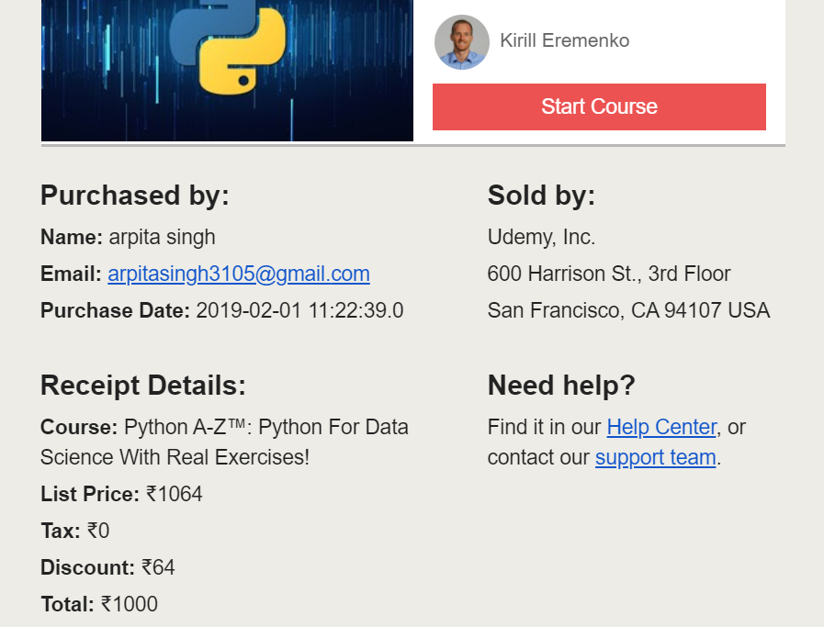
Mail Confirmation after buying Course

